Slide 1
Merage Talks 2023

Slide 2
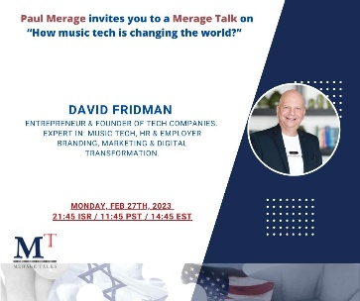
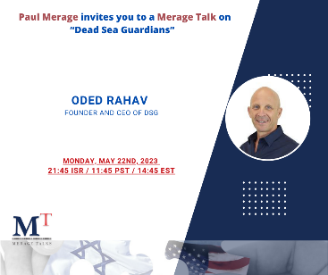
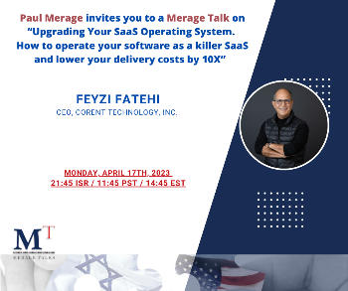
23 Merage Talk

Slide 3
January 2023
Speaker | Title | Registered | Views
Stefan Avivson | Get traction and find your product market fit | 81 | 98
MI HLS | Meet the Homeland Security participants | 43 | 214
Camren Simon | Mastering Metaphors in persuasive presentations | 63 | 165

Slide 4
February 2023
Speaker | Title | Registered | Views
Ben Wiener | The only thing that matters | 82 | 168
Maya Houri | Experience live the light festival in Copenhagen | 61 | 161
Ori Lea | Personal vs branding | 61 | 181
David Fridman | Music-Tech | 41 | 160

Slide 5
March 2023
Speaker | Title | Registered | Views
Darie Ofek | Winning the stock battle | 27 | 160
MI FinTech | Meet the FinTech participants | 40 | 181
Leonard Lane | Business growth strategies | 50 | 169

Slide 6
April 2023
Speaker | Title | Registered | Views
Feyzi Fatehi | Updating your SaaS operation | 26 | 175
Jude Barak | How to choose the right investor | 45 | 168

Slide 7
May 2023
Speaker | Title | Registered | Views
Don Thomas | Becoming an Astronaut | 42 | 190
Doron Malka | “Brandcebo”, The placebo effect of brand | 41 | 174
Oded Rahav | Dead sea guardians | 27 | 173

Slide 8
June 2023
Speaker | Title | Registered | Views
Ruban Kanapathippillai | Scaling your product | 35 | 252
Hilla Srour | Crypto and NFT | 37 | 183

Slide 9
July 2023
Speaker | Title | Registered | Views
Meet the MT | Food-Tech | 53 | 155
Niv Aharoni | Coffee workshop | 57 | 177
Fred Haney | The Fundable Starup: How Disruptive Companies Attract Capital | 69 | 178

Slide 10
August 2023
Speaker | Title | Registered | Views
Neil Rogachevsky | Israel's Declaration of Independence: The History and Political Theory of the Nation's Founding Moment | 32 | 180
Adi SJ | Boosting Team Ideation | 28 | -

Slide 11
September 2023
Speaker | Title | Registered | Views
Dionne Mejer | Starting and Growing your Revenue Engine | - | -
Mark Fowler | Revolutionary Conversations | - | -

Slide 12
Oct/Nov/Dec 2023
4 Planned Merage talks were postponed to 2024 due to the Oct 7th attack and war

